Slide 1

GIT Ways of Working
Branching & Access Control
for
HORIZON
3 Dec 2014
Arun Narayanaswamy | GEO Platform Engineering

Slide 2

Access Control
Developer Ways of Working
Branching Model at Repository Level
Repository Structure
Agenda
Notes:
Deployment outside dev scope
Key Concept – Infrastructure as Code
Why CI CD became integral part of DevOps?

Slide 3
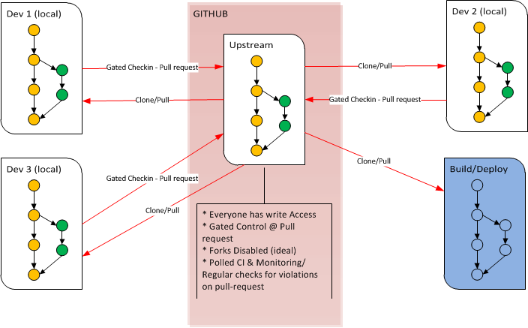
Developer Ways of Working with GIT

Slide 4
Developer Workflow with GIT
Developer workflow:
Clones repository
Creates local branch & develops on it (say “ABC” – Ideally Jira ticket ID)
Does local build and validation
Pushes branch “ABC” to remote
Has write access to write remote, but should push as branch
Creates pull request from “ABC” to release (dev) / master (if hotfix) branch
Jenkins runs gated checks on pull request
If pull request fails, developer gets notification & dev needs to rework
If pull request passes, developer job is complete
CI Steps
Jenkins keeps polling for pull requests / or get triggered as event from GIT
As soon as pull request is received, Jenkins
Clones the repo (if already there, does a fetch, pull)
Merges the source and target branch of Pull Request locally
Runs the defined gated checks (Sonar / PMD etc.)
Once all checks are green, it approves the pull request.
Else triggers mail to fail the pull request

Slide 5
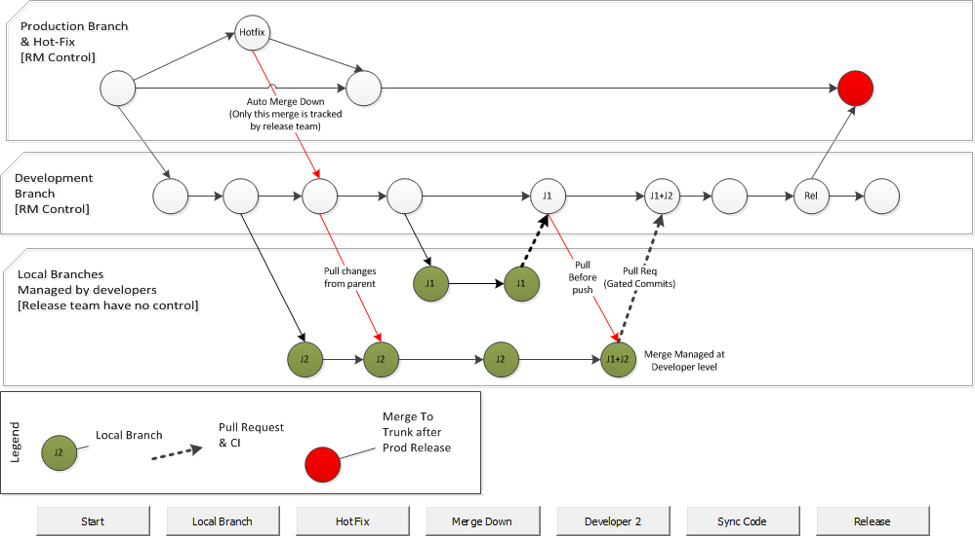
Branching Model At Repository Level

Slide 6
Local Branching Model
All features, changes, or fixes developed on independent local branch - ideally named “Jira#” they are working on
Local branches are insignificant/ beyond control of RM
Master branch would never contain broken code
CI should be triggered with pull request event
Local branches ideally set to ‘delete’ once integrated - keeps the repository clean
Hot fix - only change directly on master branch
Pull request from a local branch onto Master
Auto propagated to other branches - avoids regression
Checks - Developers using push / bypassing pull request
Jenkins job monitors and reports violations
Development branch is optional if the team has
Well established CI with good Infra and fast feedback
Appetite for risk – developing on master

Slide 7
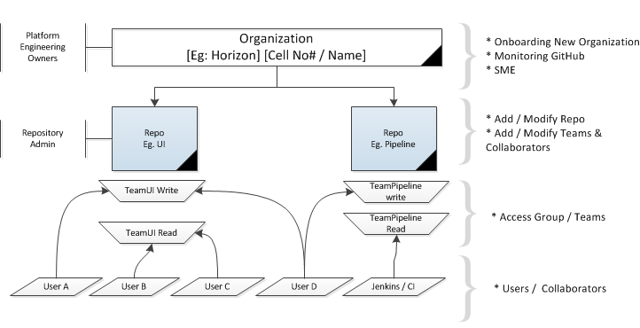
Access Control and Repo Structure – GITHub View
MEMBERS > | Ideally Everyone | Team Developers | Ramesh & RM Team | Platform Team
Repository action | Read access teams | Write access teams | Admin access teams | Owners team
Pull (read), push (write), and fork (copy) all repositories in the organization |  |  |  | X
Create and delete any repository in the organization |  |  |  | X
Create and delete the team's repositories |  |  | X | X
Change settings for repositories assigned to the admin team |  |  | X | X
Transfer repositories into, and out of, the organization account |  |  | X | X
Pull from (read) the team's assigned repositories | X | X | X | X
Push to (write) the team's assigned repositories |  | X | X | X
Fork (copy) the team's assigned repositories | X | X | X | X
Send pull requests from forks of the team's assigned repositories | X | X | X | X
Merge and close pull requests |  | X | X | X
Edit and delete their own comments on commits, pull requests, and issues | X | X | X | X
Edit and delete anyone's comments on commits, pull requests, and issues |  | X | X | X

Slide 8
Support & Monitoring
Platform Team Monitoring
Checks on the size of the repository, growth of repository
Forks, number of repositories, backup strategy
CI implementation at pull request level
CICD implementation
Infra level monitoring of GITHub and associated tools in the platform
Support:
Organization creation – New cell onboarding / COE for GIT
Training on GIT for Admins - Admins can then train developers
Admin/Team level monitoring
Access control
Team level CICD & Automation

